Slide 1
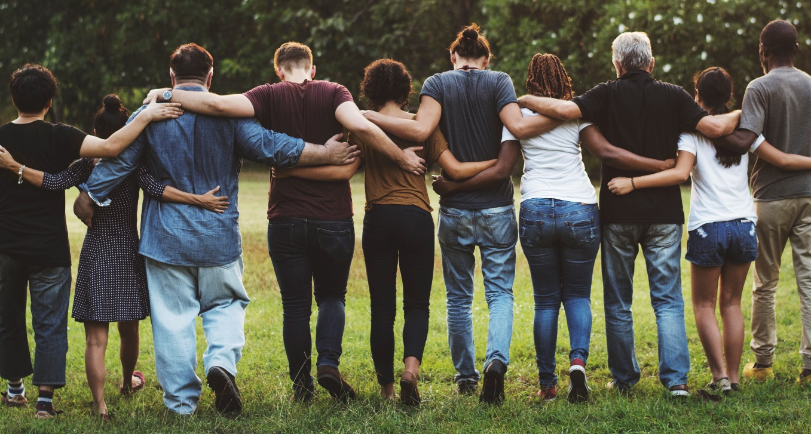
LiveWell Vision and Mission
Our Vision: Communities where we all thrive.
Our Mission: Leading a movement to build communities that support the health and well-being of all.
Notes:
LiveWell envisions Douglas County “communities where we all thrive.”
Our Mission in this work is “Leading a movement to build communities that support the health and well-being of all.”

Slide 2
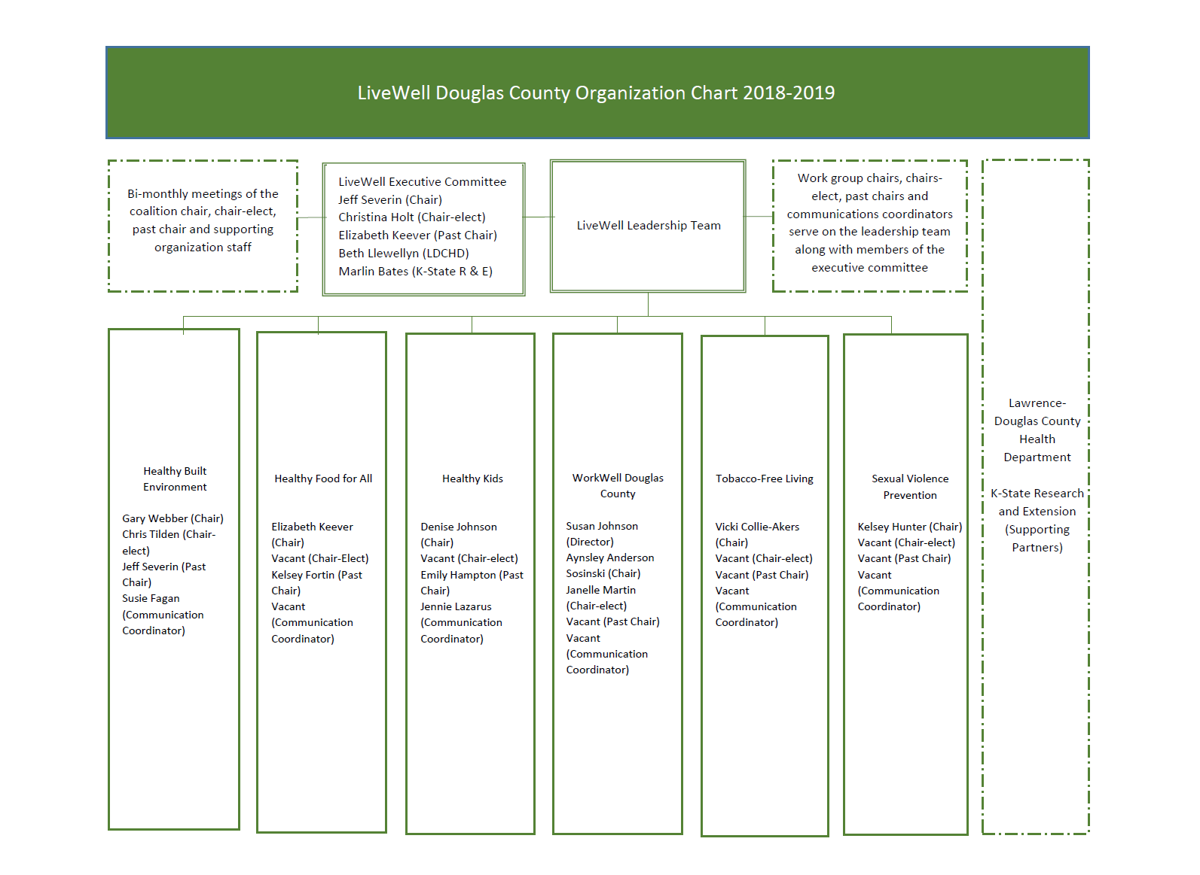
Notes:
LiveWell is proud to be continuing to lead the “Healthy Built Environment” and “Healthy Food for All” areas of the Community Health Plan.
LiveWell work groups include: Healthy Built Environment
Healthy Food for All
Healthy Kids
WorkWell Douglas County
Tobacco-free Living
Sexual Violence Prevention
LiveWell has worked with the Health Department, the Sexual Trauma and Abuse Care Center, and local community residents to form work groups to address tobacco use and sexual violence prevention, which helped our community be competitive for bringing in funds to support efforts in those areas. LiveWell will continue to utilize multi-sectoral partnerships to respond to emergent community opportunities and needs, and leverage funds for our community.
The Sexual Violence Prevention work group has wrapped up an assessment on the risk and protective factors for sexual violence and is planning for improvement.

Slide 3
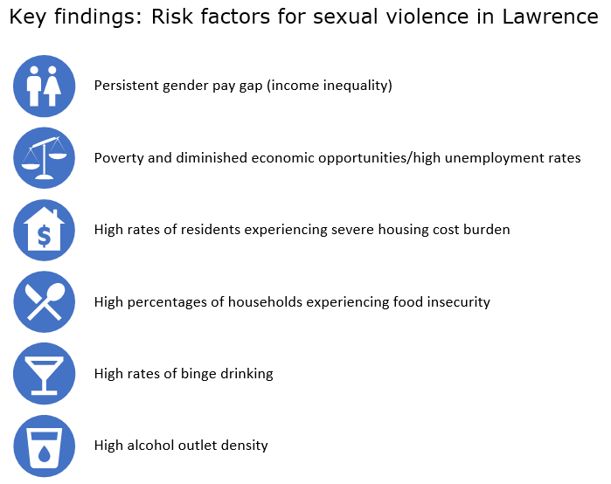
Notes:
Here you can see the key findings related to risk factors for Sexual Violence in Lawrence – and overlap with many of the issues in the community health plan:
Income inequality
Poverty
Housing
Food insecurity
Binge drinking/ high alcohol outlet density
I hope that there will be opportunities for collaboration going forward as efforts move upstream to affect social determinants.

Slide 4
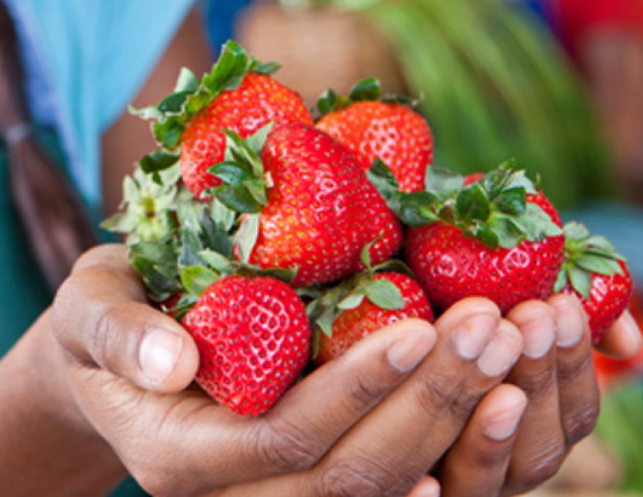
Reducing Food Insecurity
Notes:
The community-determined strategies for making these improvements to reduce food insecurity in our Douglas County communities include:
Ensuring enhanced food access for populations facing transportation barriers.
We are happy to report that Just Food has received funding to create a mobile food pantry, and will be partnering with Harvesters to retrofit the vehicle into a full mobile food pantry. This mobile food pantry will help get healthy food to some of the most vulnerable members in our community.
Growing food recovery practices and policies to supply safe, nourishing food to those in need.
Sarah Hartsig has been working with USD 497 on food recovery practices.
Continuing to strengthen and expand the FuelGood Healthy Pantries Initiative to promote adoption of health-promoting policies and practices.
Removing barriers to and strengthening utilization of public food assistance programs for families with children and seniors.
The Summer Food Service Program has been expanded to Baldwin City. The city has qualified for the U.S. Department of Agriculture-funded program this year. The Baldwin City school district is sponsoring the program. There are sites at the Baldwin Elementary Intermediate Center, City Swimming Pool, Academy of Dance and Voice, Baldwin City Library, and Lumberyard Arts Center.
Supporting advocacy efforts
Extending food pantry evening/ weekend availability
Just Food extended its evening hours and is now open every day until 6pm, and by appointment.
And growing “Hunger and Health” efforts to enhance integration of social services and health care (such as diabetes screening and self-management support at local pantries)
Just Food and LMH are now partnering to provide free on-site health screenings at LMH each month, including blood sugar, blood pressure, and cholesterol (began Feb 26)

Slide 5
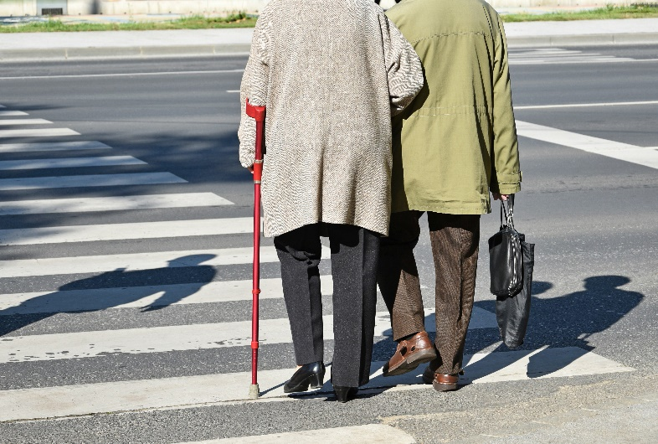
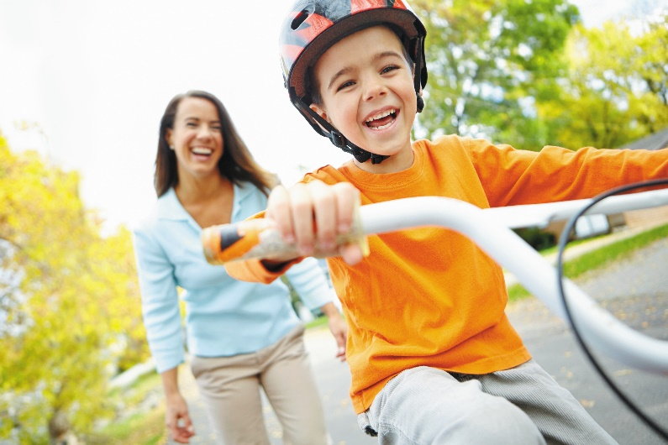
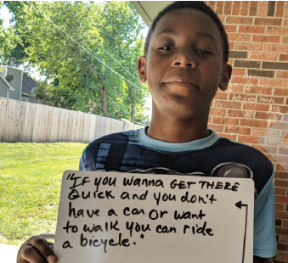
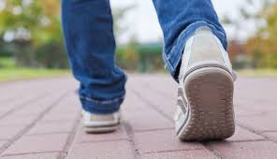
Healthy Built Environment
Notes:
Strategies for making improvements to our built environment include:
Working with local cities to advance a safe and robust pedestrian and bicycle network
The Metropolitan Planning Organization (MPO) is in the process of finalizing an update to the Douglas Countywide Bikeway Plan. Specifically, a section called “Lawrence Bikes” is focusing on the bikeway network in Lawrence will be integrated into the existing bikeway plan. Public comment is being accepted through tomorrow (June 14).
In February the city of Lawrence received a $480,000 Kansas Department of Transportation (KDOT) “Transportation Alternatives” grant to extend the Lawrence Loop from its current terminus in east Lawrence at 11th Street to approximately 7th Street. KDOT requires a 20% local match, and it is anticipated the city will approve this match as part of the 2020 budget process. A timeline for construction has not been provided to the public at this time.
Working with school districts and municipalities to assure completion, adoption, and implementation of regional or school district Safe Routes to School Plans
The MPO is also launching an effort to create a regional Safe Routes to School Plan. There is little detail available yet on the timing and process for the development of the plan, but it will likely start soon, as MPO staff have indicated this in recent public forums.
Supporting school districts’ efforts to adopt evidence-based policies that support opportunities for youth to be physically active
Supporting ongoing development of public transit, with access for people of all abilities
Promoting community initiatives that support well maintained, equitably funded sidewalk networks.
The sidewalk maintenance debate is heating up a bit, and there are sidewalk improvements being made in the northwest quadrant of the city where the sidewalk maintenance program has been initially implemented.
And increasing the number of workplaces that are actively engaged with Healthy Eating Active Living (HEAL) initiatives

